Slide 1

ENFORCE MODEL SECURITY
BY NITIN

Slide 2

OBJECTIVE
I learned about working with Auditing and Monitoring Security in Power BI.
Understood the performance impact of RLS and learned how to write efficient DAX security rules.

Slide 3
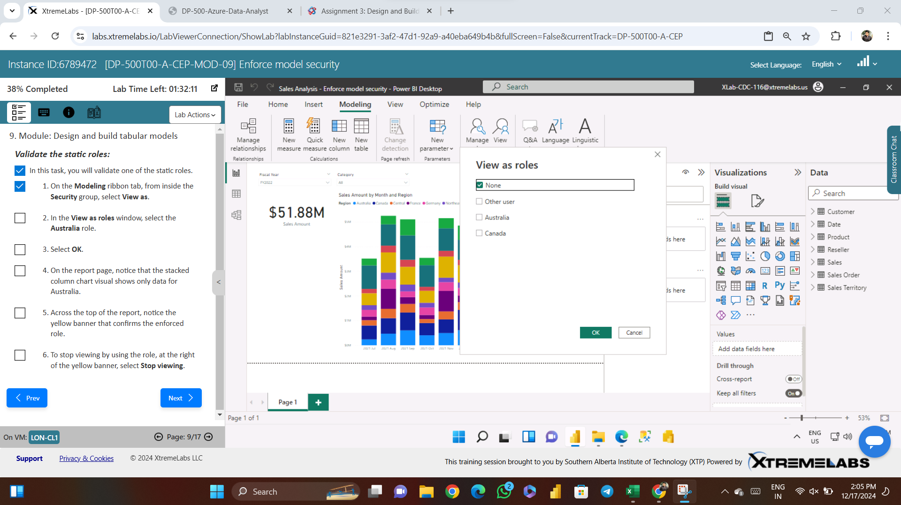

Slide 4
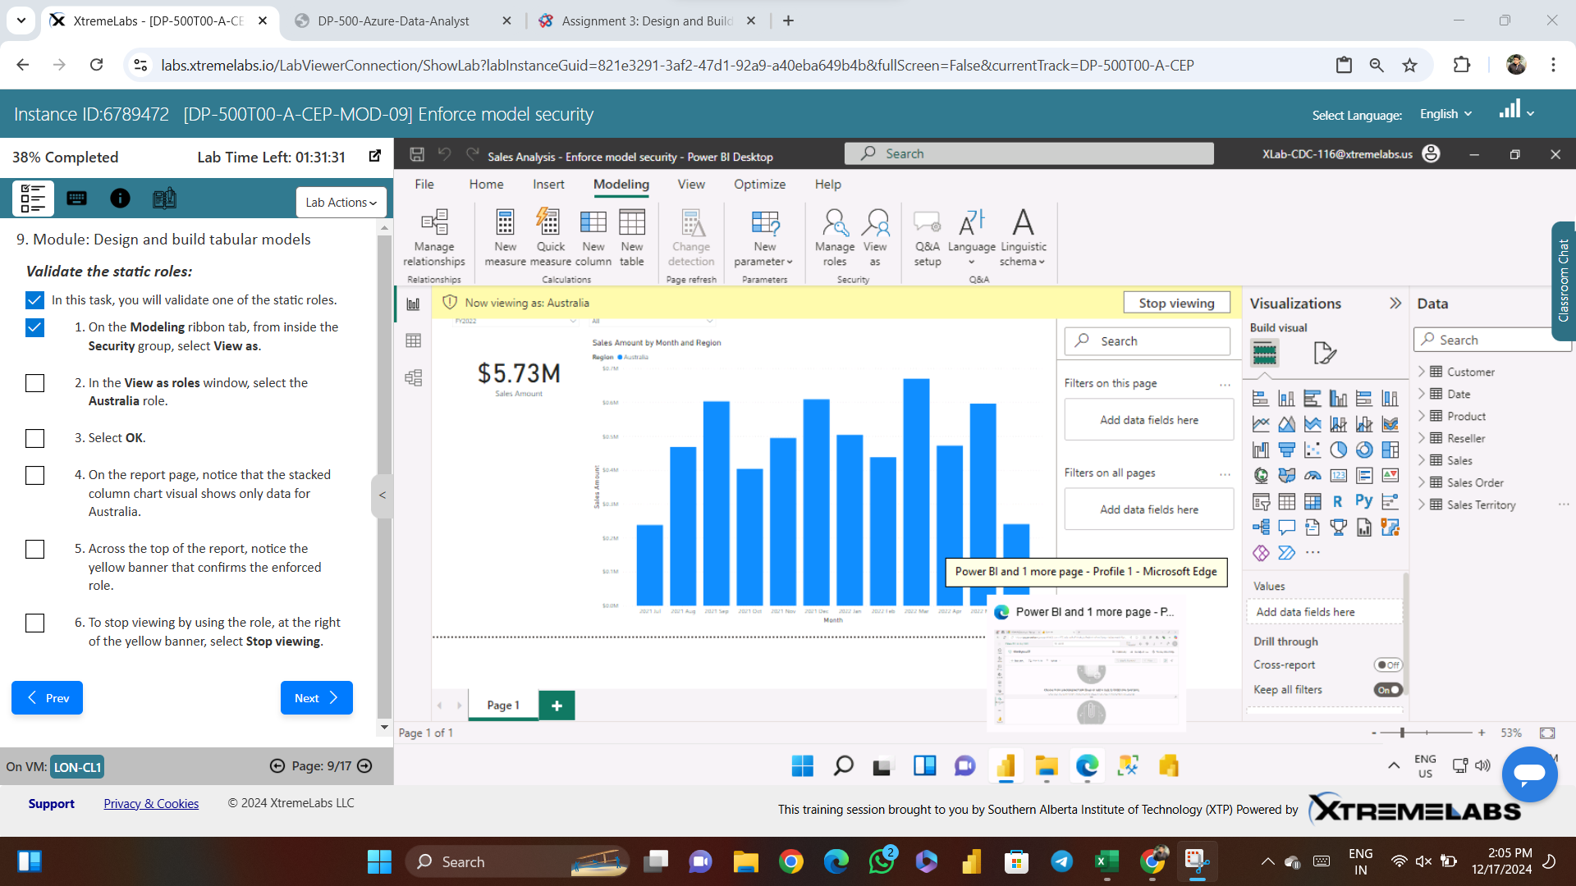

Slide 5
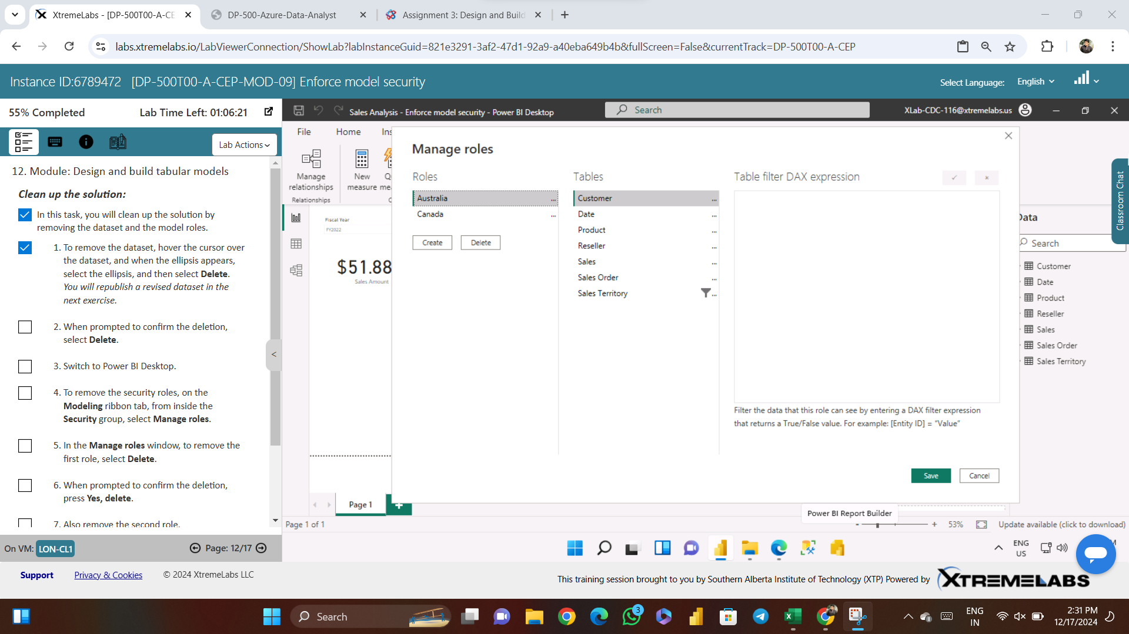

Slide 6
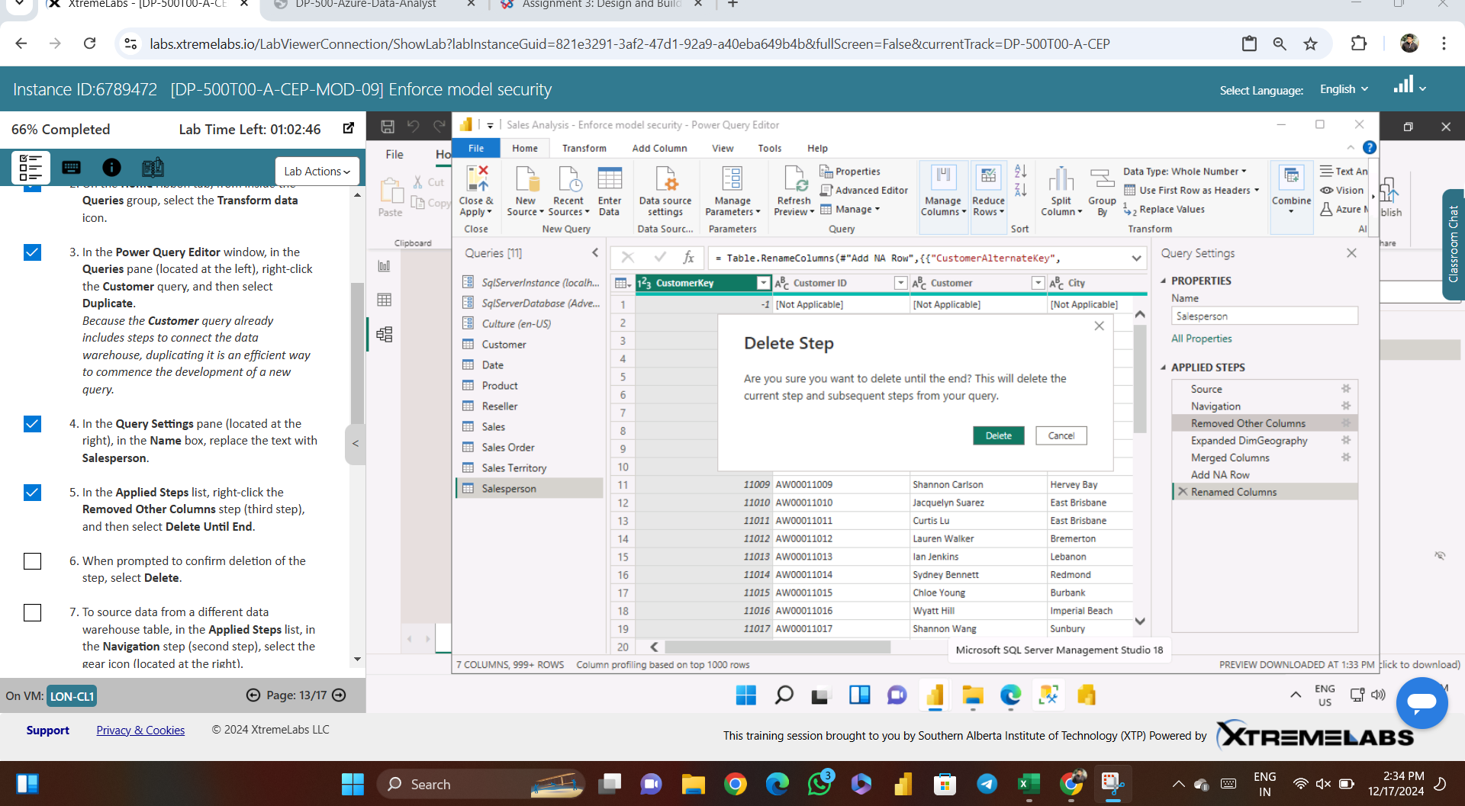

Slide 7
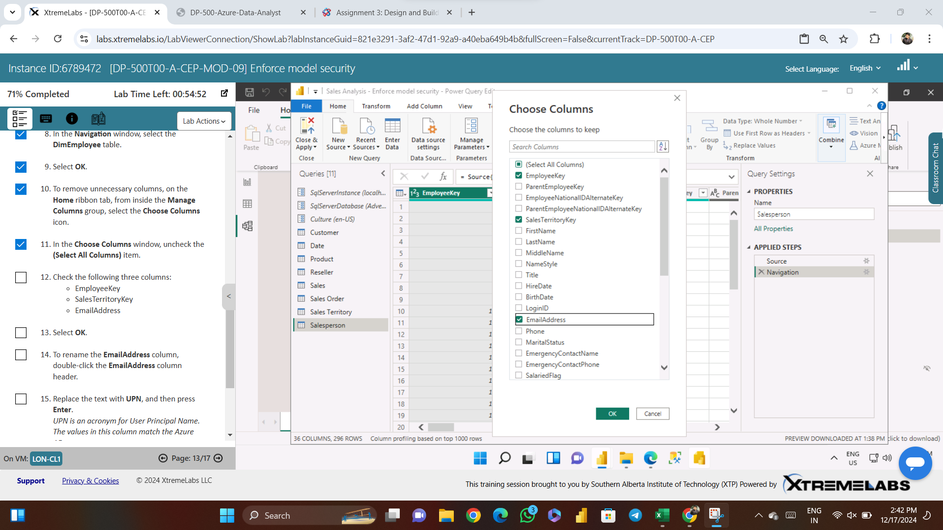

Slide 8
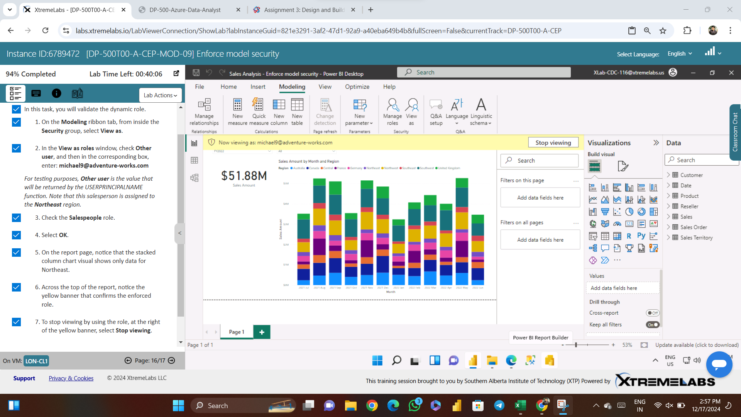

Slide 9
